Slide 1
Soil & Water Health Examining
Theme : Primary Production
Team : Blanks

Slide 2
Introduction
The primary production stage of the supply chain encompasses agricultural activities, aquaculture, fisheries and similar processes resulting in raw food materials. This first stage in the chain includes all activities related to the harvest, handling and storage of food products before they move to either processing or distribution. Any level of processing of raw food products does not fall within this stage of the supply chain but would rather be classified as processing and manufacturing.
Examples of primary production activities are: farming, fishing, livestock rearing and other production methods.
Food losses in primary production can be caused by many factors, including but not limited to: pests or adverse meteorological pHenomena, damage incurred during harvest, lack of proper storage infrastructure, cosmetic or size requirements or economic or market variability (i.e., cancellation of orders, rigid contract terms, price variability or high labor costs).

Slide 3
SOIL
The world has lost a third of its arable land due to erosion or pollution in the past 40 years, with potentially disastrous consequences as global demand for food soars, scientists have warned.
New research has calculated that nearly 33% of the world’s adequate or high-quality food-producing land has been lost at a rate that far outstrips the pace of natural processes to replace diminished soil.
The erosion of soil has largely occurred due to the loss of structure by continual disturbance for crop planting and harvesting. If soil is repeatedly turned over, it is exposed to oxygen and its carbon is released into the atmospHere, causing it to fail to bind as effectively. This loss of integrity impacts soil’s ability to store water, which neutralizes its role as a buffer to floods and a fruitful base for plants.
Degraded soils are also vulnerable to being washed away by weather events fueled by global warming. Deforestation, which removes trees that help knit landscapes together, is also detrimental to soil health.

Slide 4
Soil Fertility
Soil pH is the measure of the acidity (sourness) or alkalinity (sweetness) of a soil. A simple numerical scale is used to express pH. The scale goes from 0.0 To 14.0, with 0.0 being most acid, and 14.0 being most alkaline. The value, 7.0 is neutral--i.e., neither acid or alkaline.
So, pH of the soil plays a vital role in the growth of the crops in the primary production.
Soil pH is important because it influences several soil factors affecting plant growth, such as (1) soil bacteria, (2) nutrient leaching, (3) nutrient availability, (4) toxic elements, and (5) soil structure. Bacterial activity that releases nitrogen from organic matter and certain fertilizers is particularly affected by soil pH, because bacteria operate best in the pH range of 5.5 to 7.0. Plant nutrients leach out of soils with a pH below 5.0 much more rapidly than from soils with values between 5.0 and 7.5. Plant nutrients are generally most available to plants in the pH range 5.5 to 6.5. Aluminum may become toxic to plant growth in certain soils with a pH below 5.0. The structure of the soil, especially of clay, is affected by pH. In the optimum pH range (5.5 to 7.0) clay soils are granular and are easily worked, whereas if the soil pH is either extremely acid or extremely alkaline, clays tend to become sticky and hard to cultivate.

Slide 5
Fruit Plants
Apple 5.5-6.5
Blueberry, high bush 4.5-5.5
Cherry, sweet 6.5-8.0
Pear, common 6.5-7.5
Plum, American 6.5-8.5
Raspberry, black 5.5-7.0
Raspberry, red 6.0-7.5
Strawberry 5.5-6.5
Grapes 5.5-7.0

Slide 6
Vegetables
Asparagus 6.0-8.0
Beans 6.0-7.0
Beets 6.5-8.0
Broccoli 6.0-7.0
Cabbage 6.0-7.5
Cantaloupe 6.0-7.5
Carrots 5.5-7.0
Corn 5.5-7.5
Cucubers 5.5-7.0

Slide 7
Eggplant 5.5-6.5
Lettuce 6.0-7.0
Onions 6.0-7.0
Peas 6.0-7.5
Peppers 5.5-7.0
Potatoes 4.8-6.5
Sweet Potatoes 5.2-6.0
Radishes 6.0-7.0
Rhubarb 5.5-7.0
Spinach 6.0-7.5
Squash 6.0-7.0
Tomatoes 5.5-7.5

Slide 8
Objective
We as a team believe that the quality of soil and he required chemical properties are the important factors for the growth of crops but we have to keep in mind a lot of things like degradation. So we have to replenish the soil from time to time using nothing but natural methods to retain the quality of crops
We can achieve this using our method.

Slide 9
Problem
According to the data, a pH of 5.5-7.0 is required for proper growth of the plants. So, in-order to maintain proper pH, it must be regularly checked.
Also, soil fertility is directly dependent upon the water used for irrigation & other purposes. So, the water contamination level needs to be under surveillance.
Also, water content must be taken into consideration because excess of water will destroy the crop in the initial stages as well. So, water content is an important factor in growth of the crops.
Moreover, air pollution has hazardous effect on the crops. It may directly or indirectly hit the crop. It may lead to low quality of product leading to decaying of the crops much faster than the normal rate.

Slide 10
Soil Solution
Using Arduino UNO & pH sensor(Analog, SKU:SEN0161) , the pH of the soil can be regularly checked.
This pH will not only be indicated on the display attached to the product, but will also be uploaded to the drive so the person can remotely check it. Also, the data will get uploaded to the app via GSM module dealing with primary production.

Slide 11
START
Connect Bluetooth
N
Is bluetooth enabled?
Y
READ DATA
Read data from pH. A sensor
Read data from pH. B sensor
Send data by Bluetooth
Read data from pH. C sensor

Slide 12
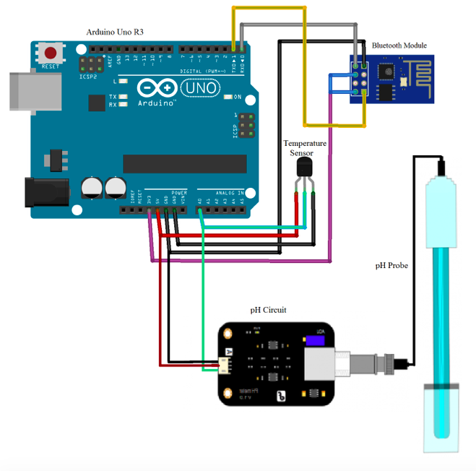
Communication

Slide 13
Water
Water is essential to life. It need not be spelt out exactly how important it is. Yet water pollution is one of the most serious ecological threats we face today.
What is water pollution?
Water pollution happens when toxic substances enter water bodies such as lakes, rivers, oceans and so on, getting dissolved in them, lying suspended in the water or depositing on the bed. This degrades the quality of water.
Not only does this spell disaster for aquatic ecosystems, the pollutants also seep through and reach the groundwater, which might end up in our households as contaminated water we use in our daily activities, including drinking.

Slide 14
Objective
As important as soil is we also have to keep in mind that water is also an important aspect of agriculture. The quantity of water plays a vital role in what is the agriculture .
We check this quantity of water by checking amount of moisture in the soil, as the moisture content gives us the idea and the condition of the soil. (Higher the moisture content more the soil is well drained, but it’s not necessary that it is good for that type of soil .

Slide 15
Water Solution
Water contamination level should be checked & moreover, the temperature of the water plays a vital role in the growth of crops.
So, not only water contamination level should be checked using an Arduino UNO & water contamination sensor, but also the temperature(DHT22/11 Humidity and Temperature Sensor) & the water content( Soil Moisture Sensor ) must be checked.
If the humidity level or water content is low, then Arduino should take control & should start the pump automatically. It will automatically close the pump once the required amount of water reaches the crops. The pump will be connected to a dc motor than will automatically turn on or off the pump as & when required.

Slide 16
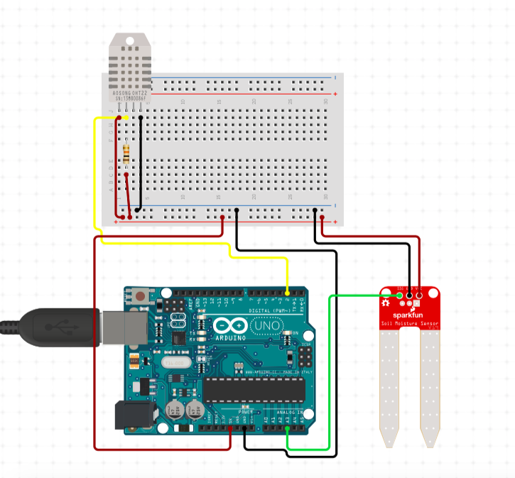
Temperature & Humidity sensor
Moisture content sensor
Arduino uno R3

Slide 17
START
HUMIDITY (PIN A0
TAKE HUMIDITY DATA
If threshold value<800
WET
DRY
PUMP OFF
RED LED ON
GREEN LED ON
PUMP ON

Slide 18
Water & Soil
Soil contamination or soil pollution as part of land degradation is caused by the presence of xenobiotics(human-made) chemicals or other alteration in the nature soil environment. It is typically caused by industrial activity, agricultural chemicals or improper disposal of waste. This waste flows into the soil via water. If the contaminated water is used for the irrigation purpose, then the soil will get affected & that will eventually lead to soil pollution.

Slide 19

Temperature sensor
Signal conditioning
Microcontroller Arduino Genunio 101
GPS
pH sensor
HTTP
Webpage displaying result
GPRS
Dissolved Oxygen sensor
Turbidity sensor
POWER SOURCE

Slide 20
Crop Rotation
Certain crops need certain parameters to grow, as we already specified in above tables on what grow according to a certain pH. But this is not the lone parameter for growing a crop, other stuff like moisture and ambient temperature also matter
For Eg. Apple grows best in the soil of pH 5.5-6.5 but needs a cold well drained soil.
Similarly,
Black Raspberries grow in the soil of pH 5.5-7 but are
best grown in a sunny, moist and well drained climatic
conditions.
But we cannot deny that the parameters change after every harvest. But what is great is the repeatability of our devices.

Slide 21
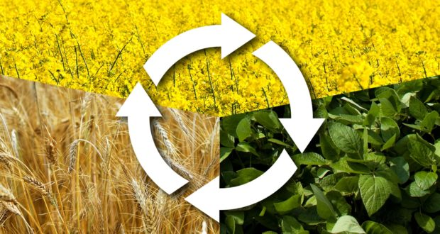
Thus we will like to suggest the farmer keeping in mind not only these parameters but also the soil quality in mind *(Such as nitrogen fixation)

Slide 22
Air Pollution
Crops can be injured when exposed to high concentrations of various air pollutants. Injury ranges from visible markings on crop leaves, to reduced growth and yield, to premature death.
The development and severity of the injury depends not only on the concentration of the particular pollutant but also on a number of other factors. These include the length of exposure to the pollutant, the plant species and its stage of development as well as the environmental factors conducive to a buildup of the pollutant and to the preconditioning of the plant, which makes it either susceptible or resistant to injury.

Slide 23
Objective
As dangerous as it sounds for a lifestyle the pollutants in the air not only harm people but also plants.
Plants suffer even worse conditions as they are stationary.
Also Dry areas have a higher chancer of natural fires caused by the sun such a thing may lead to huge destruction of crops.
Thus we have devised an alarm system for when there is fire in the field.

Slide 24
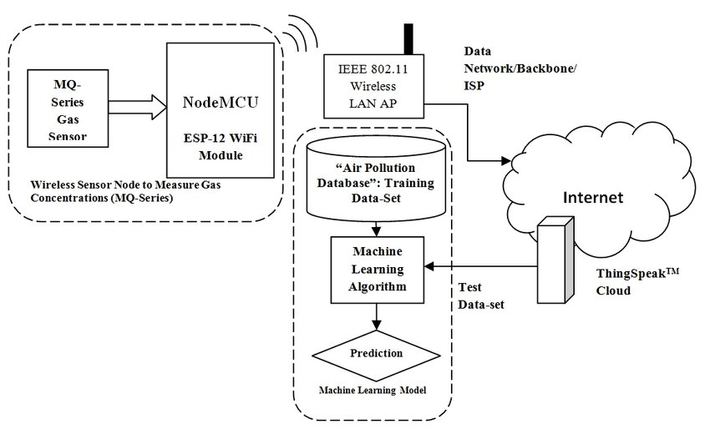
Air Pollution Solution

Slide 25
}
Air Pollution Solution
Arduino UNO
Carbon Dioxide
Relay
Fire Sensor
Exhaust Fan
Display
Calling Fire brigade
LPG or Gas Sensor

Slide 26
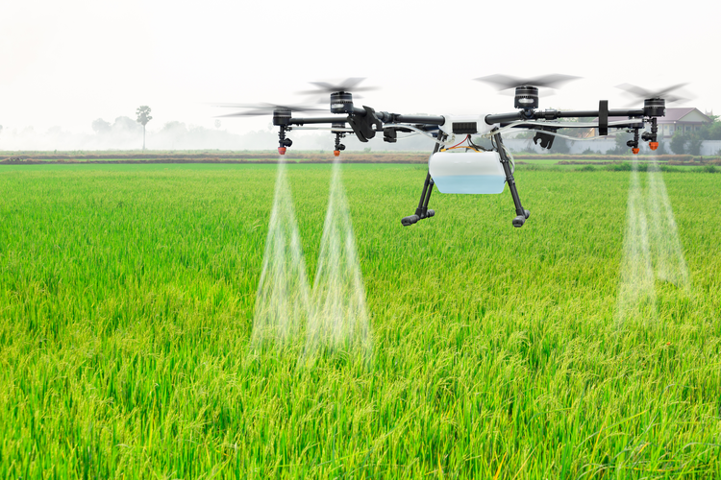
Use of Drones for cultivation
We suggest the use of drones in India to supply the supplements needed in agriculture.
We can also use this to scout our sensors as they they may be damaged due to unknown reasons.
Also drones can be used to fend off small fires. Which need immediate attention

Slide 27
Business Objectives
Apart from agricultural uses we could say that the sensors we are using are multipurpose.
Like we could use the moisture sensor to find moisture content before building lands as the quality of soil will affect the construction of the building.
Similarly we can use the temperature probe and pH meter for various other reasons.
It is also imperative that the smoke sensors we are using are already been. used in buildings and complexes as a part of their safety regulation.

Slide 28
Thank you

